Slide 1
Digital wellbeing
Ensuring learners’ safety in a digital world
Eugenia Casariego Artola
Development & Advocacy Coordinator
3 October 2024
Notes:
Digital citizenship is the ability to navigate our digital environments in a way that's safe and responsible and to actively and respectfully engage in these spaces.

Slide 2
Briefly
Towards a definition of digital wellbeing
Promoting digital wellbeing: strategies
Ensuring safe learning environments: eSafety
Your eTwinning projects
Image source: Yan Krukau

Slide 3
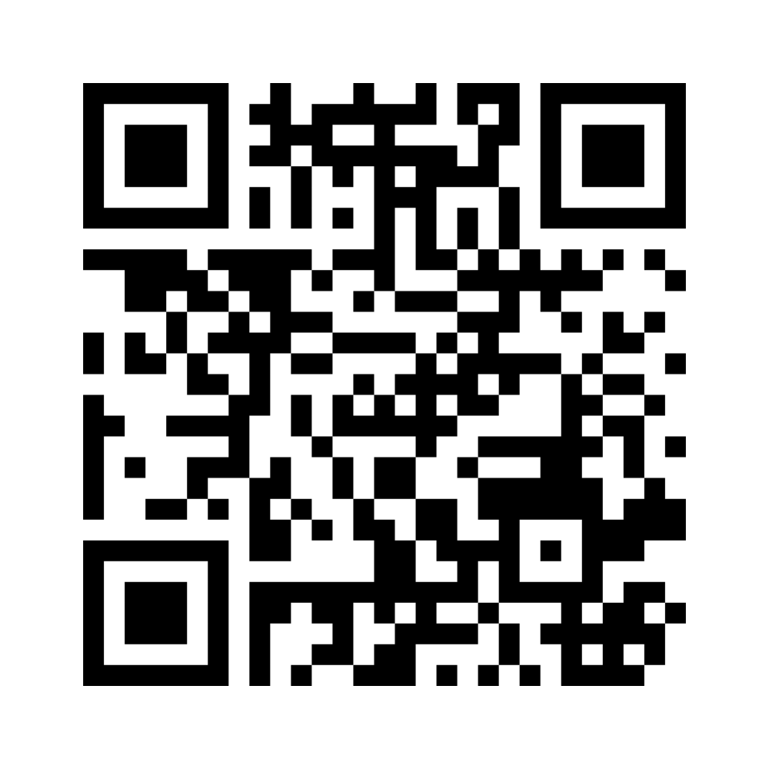
What is digital wellbeing for you?
What comes to mind when you read “digital wellbeing”?
What are some key elements to ensuring it?
What relevance does it have for schools?
Who are important stakeholders in ensuring it?
3 keywords
Go to menti.com and insert the code 13 78 86 OR scan the QR code

Slide 5
Digital wellbeing
“The impact of digital technologies on what it means to live a life that is good for a human being in an information society” (Burr and Floridi, 2019)
“The enhancement and improvement of human well-being, in the intermediate and long term, through the use of digital media” (UNESCO)
At school:
Use of digital tools in the classroom (balance)
Online safety and data privacy
Attention to cyberbullying
Training in digital skills
Go to menti.com and insert the code 13 78 86
Notes:
The first definition is more of a warning, the second definition highlights the potential for digital technologies to have a positive impact on health
Digital wellbeing as an emerging concern in schools:
Cyberbullying becoming a more prevalent type of bullying
Digital technology increasigly used in learning activities
Privacy and data protection

Slide 7
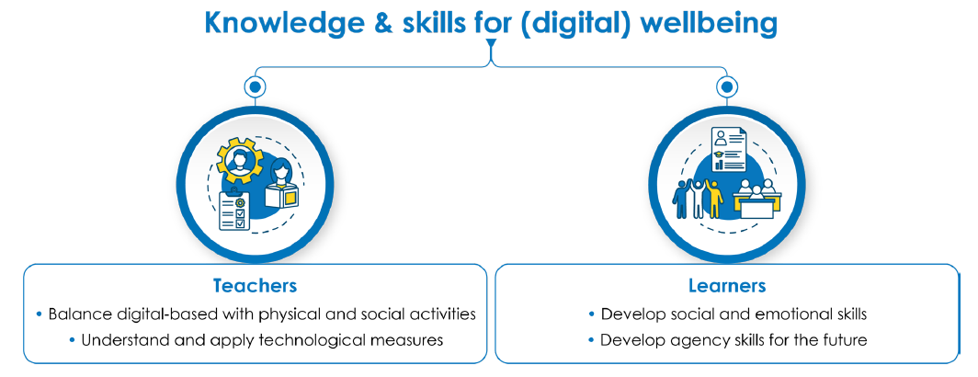
Promoting digital wellbeing: strategies
Notes:
According to OECD, students need support in developing knowledge AND attitudes and values to promote wellbeing

Slide 8
Digital wellbeing: role of teachers
Focus: to develop teachers’ knowledge and skills to promote (digital) wellbeing.
Balancing digital-based and social activities
Technology as a support to pedagogy
Allocating screen time reasonably (developing skills vs passive activities)
Ensure cooperation among students
Understanding technological measures
Self-regulation and parent/teacher control tools
Applications to monitor students’ work and mood
Alternatives to banning devices
Notes:
Schools in NL, PT and SP now banning devices (phones). Needed?
Learning is a social activity -> Tech can promote that

Slide 9
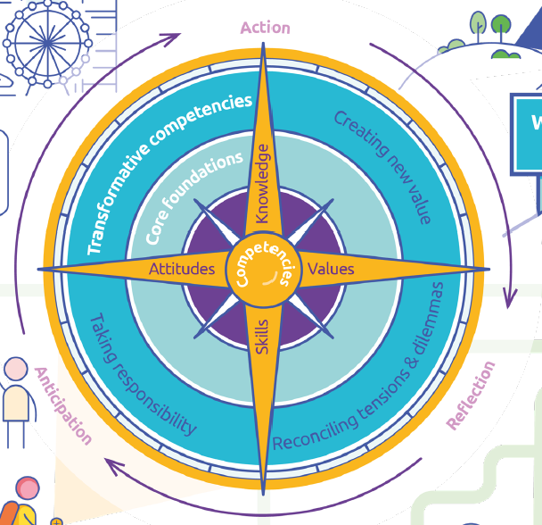
Digital wellbeing: role of students
Focus: to build learners’ knowledge, competence and attitudes.
Developing social skills
Support learners’ development and interactions (offline and online)
Promote a safe and inclusive school climate
Boost digital literacy and skills
Teach online safety practices
Boosting agency and self-regulation
Prepare students for a (digital) future
Develop learners “accountability” and agency
Empower learners to take responsibility
Tools such as the OECD Learning Compass 2030
Notes:
Social and emotional skills are needed for wellbeing in a digitalised world
Student agency for 2030, defined by the OECD as the capacity to set a goal, reflect and act
responsibly to effect change, is rooted in the belief that students have the ability and the will to
influence positively their own lives and the world around them.

Slide 10
Achieving digital wellbeing is a path of personal growth that requires education rather than restrictions.

Slide 11
Ensuring safe learning environments: eSafety
eSafety is the safe and responsible use of technology.
Key principles:
Whole-school approach
Teacher training
Positive and proactive approach, avoid scaremongering
Engagement from families, pupils and the community
Effective monitoring and evaluation
Notes:
Children in the EU in 2020 spent twice as much time – estimated at almost three hours a day – online as in 2010 (EU Kids Online 2020: Survey results from 19 countries)

Slide 12
What’s next? Learning and engagement opportunities
Better Internet for Kids (BIK) portal offers resources, support and a community to learn more of digital safety: https://www.betterinternetforkids.eu/ New portal in October!
Participate in an online consultation on the first BIK+ strategy. Register until 18 October: EUSurvey - Survey (europa.eu)
Registration for the menABLE MOOC on online Gender-Based Violence is open Tackling Gender-Based Violence Online | European Schoolnet Academy. Course starts on 21 October.
Safer Internet Forum will take place on 21 November, you can follow the event online.

Slide 13
What’s next? Learning and engagement opportunities
The BIK MOOC “An Evolving Online Safety Landscape” launched in spring 2024, the course remains open: An Evolving Online Safety Landscape | European Schoolnet Academy.
KidActions has published a toolkit with activities to help understand, prevent and respond to cyberbullying KID_ACTIONS | Kick-off preventing and responding to children and adolescent cyberbullying through innovative monitoring and educational technologies (kidactions.eu)
eSafety Label is an accreditation and support service for schools, which enables them to improve their digital safety, evaluate it and share best practices with peers.
Perspective series, Wellbeing in a digital world, Issue 12, December 2023.

Slide 14
eTwinning projects: find a match!
Would you carry out an eTwinning project on the topic of digital wellbeing? How would this project look like? What is your school interested in?
Add a note on the Padlet describing your project idea in a few lines. Don’t forget to add your country and city where your school is located.
If you read about a project you are interested in, write a comment on the note and find each other during the seminar!
https://padlet.com/eugeniacasariego/eTwinning_digi_wellbeing

Slide 15
www.eun.org

